Slide 1
Government Dataset
Party wise Performance national party 2024

Slide 2
Introduction
Elections serve as a fundamental pillar of democracy, shaping the political landscape by determining which parties and leaders will govern. This dataset provides a detailed analysis of the performance of major national parties in a recent election, focusing on key electoral metrics such as the number of candidates contested, seats won, total votes secured, and vote share percentages. By examining these factors, we can gain valuable insights into voter preferences, party influence, and overall electoral competitiveness. The data highlights significant trends, such as the correlation between the number of candidates fielded and actual electoral success, as well as disparities in vote share and seat conversion rates. Some parties may have contested numerous seats but failed to secure wins, while others demonstrated strong voter confidence by achieving higher success rates despite fielding fewer candidates. This analysis not only helps in understanding past election outcomes but also serves as a useful resource for political strategists, researchers, and policymakers to assess electoral dynamics and predict future trends.

Slide 3
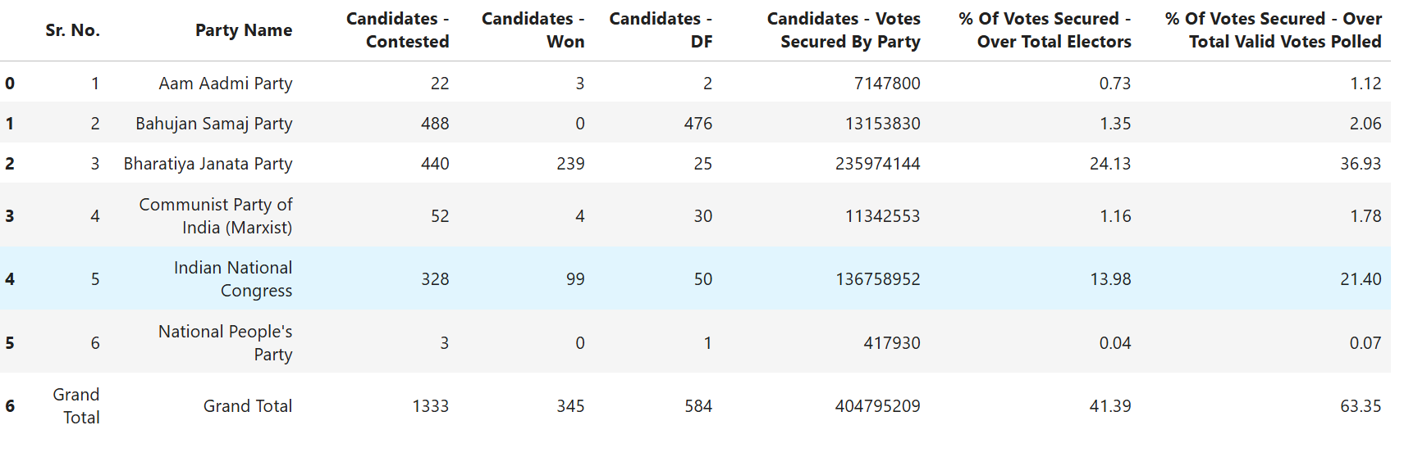
Overview

Slide 4
Column Description
Sr. No. – Serial number
Party Name – Name of the political party
Candidates - Contested – Number of candidates fielded
Candidates - Won – Number of candidates who won
Candidates - DF – Possibly disqualified or forfeited candidates
Candidates - Votes Secured By Party – Total votes secured by the party
% Of Votes Secured - Over Total Electors – Percentage of votes secured over total electors
% Of Votes Secured - Over Total Valid Votes Polled – Percentage of votes over total valid votes

Slide 5
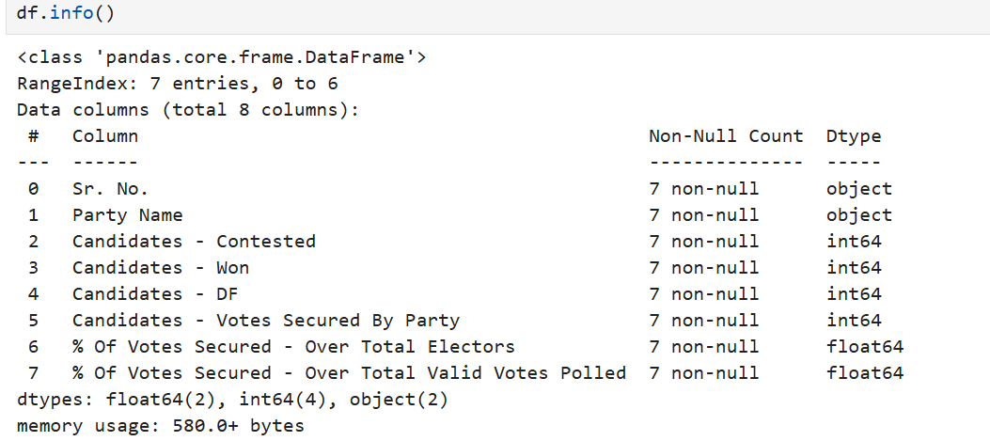
Data Cleaning

Slide 6
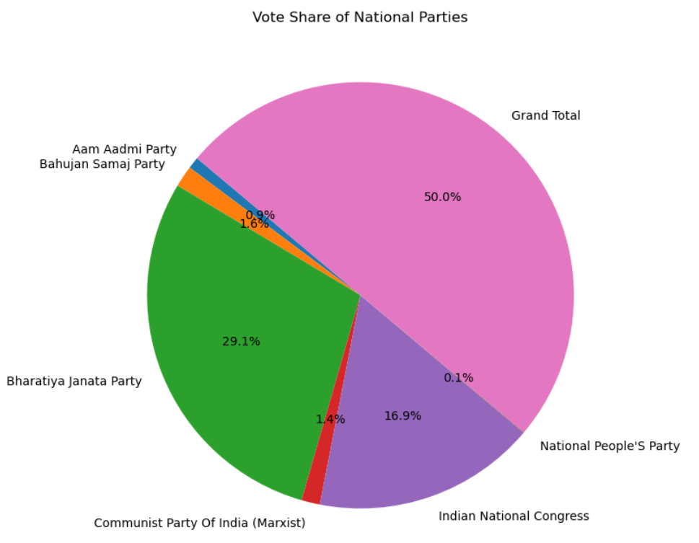
Vote Share of National Parties

Slide 7
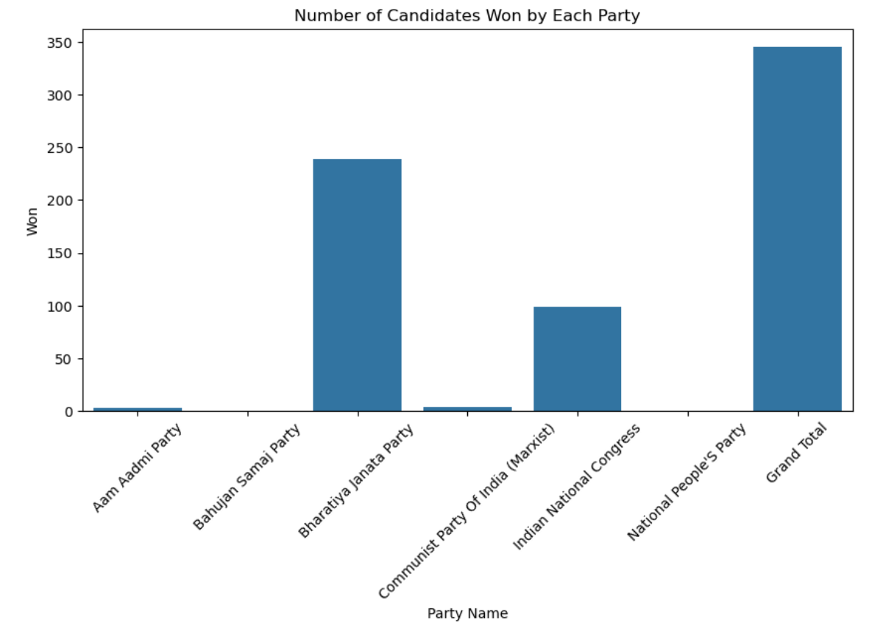
Number of Candidates Won by Each Party

Slide 8
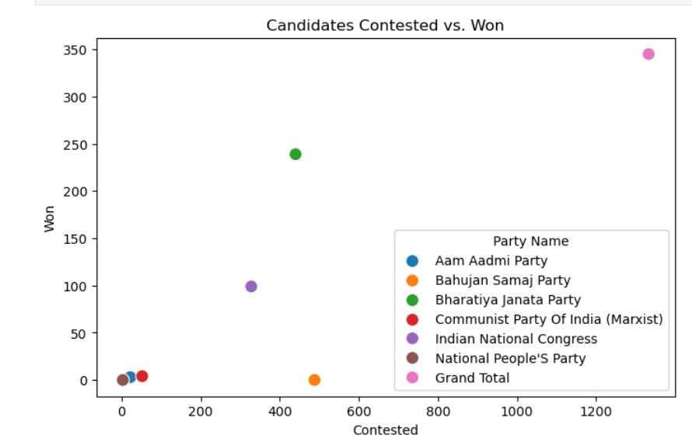
Candidates Contested Vs.Won

Slide 9
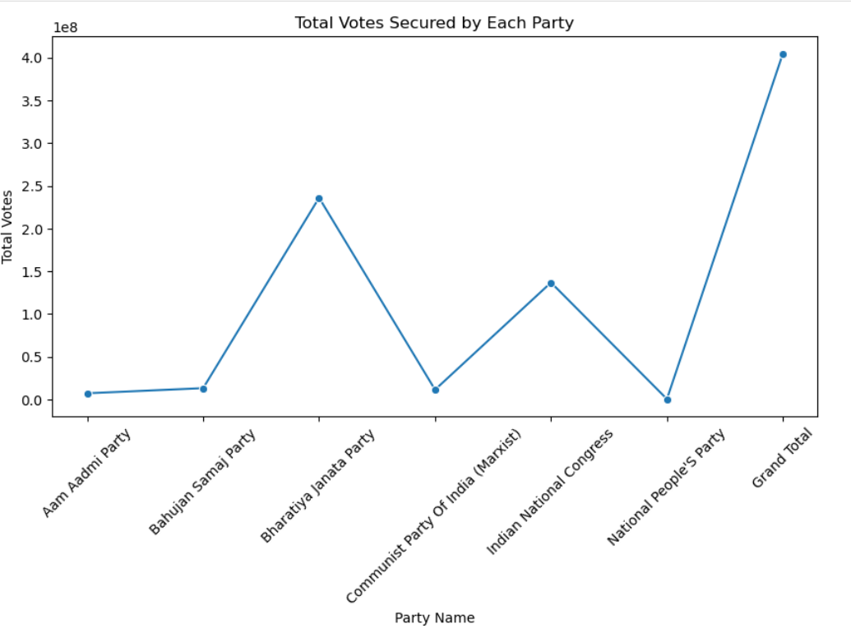
Total Votes Secured by Each Party

Slide 10
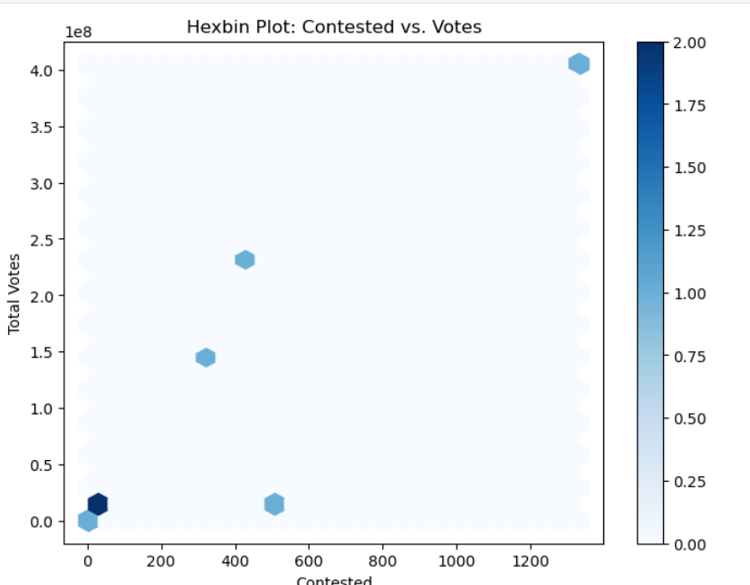
Contested Vs Votes

Slide 11
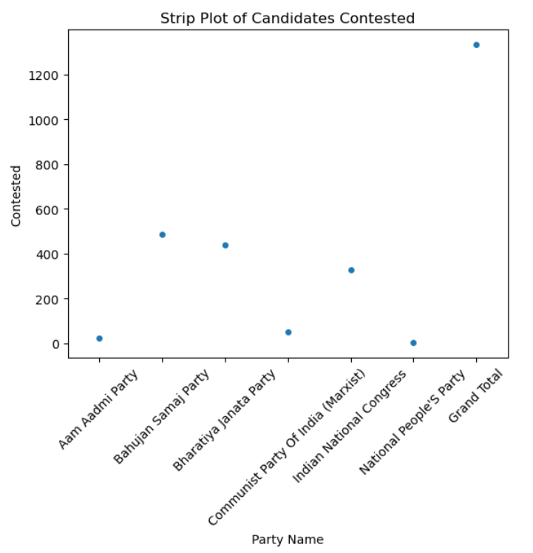
Candidates Contested

Slide 12
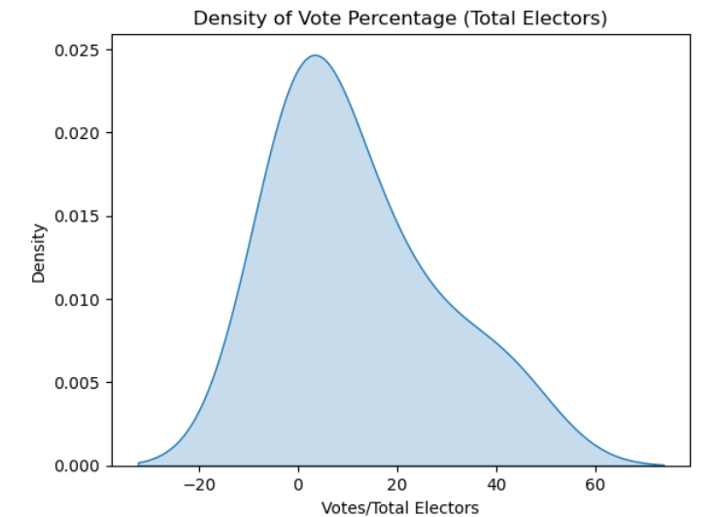
Density of Vote Percentage

Slide 13
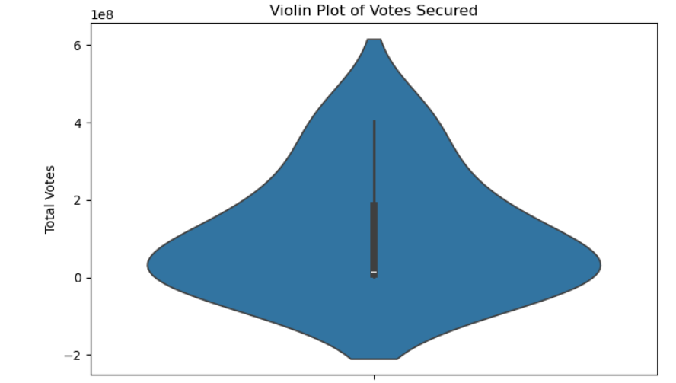
Violin Plot

Slide 14
Final Observations
The dataset reveals several key observations about the performance of national political parties in the election. It highlights significant disparities in electoral success, with some parties fielding a large number of candidates but securing few or no seats, while others demonstrated strong voter support with high seat conversion rates. For instance, the Bharatiya Janata Party (BJP) contested a substantial number of seats and secured a significant share of votes, translating into a high number of wins. In contrast, parties like the Bahujan Samaj Party (BSP) fielded many candidates but failed to win any seats, indicating a gap between contesting efforts and voter preference. The percentage of votes secured over total electors and valid votes polled also provides insight into party influence, showing which parties had a broad appeal among the electorate. Additionally, the data suggests that while vote share is an important factor, it does not always directly translate into electoral victories, as regional dynamics and constituency-based support play a crucial role.

Slide 15
THANK YOU

